Slide 1
Software Engineering and Architecture
Pattern Catalog: Null Object

Slide 2
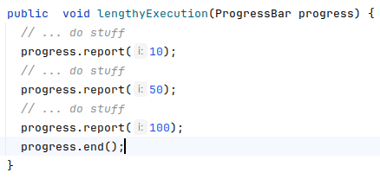

Motivation
Implementation of lengthy operation, but…
To improve usability we show a progress bar ☺
Uhum, Automated test?
Popping up progress bars?
No, we do not want that, so?
Absense = Null Reference?
progress = null;

Slide 3
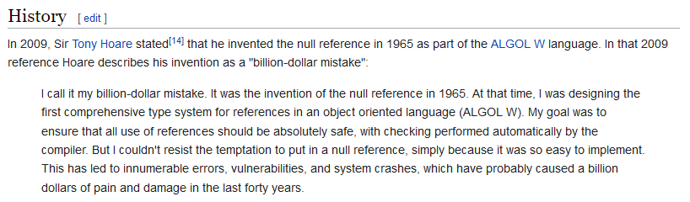
The Null Pointer
Null pointer = absence of an object
[in Machine code, it is address 0L in memory]

Slide 4
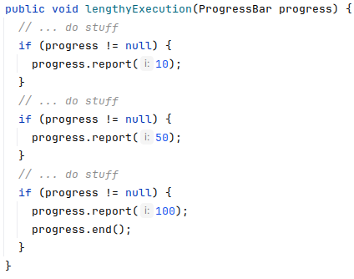
Motivation
Ups – Null pointer exceptions ☹
Solution
Avoid it with guards
No, no, no ☹
Low analyzability…

Slide 5
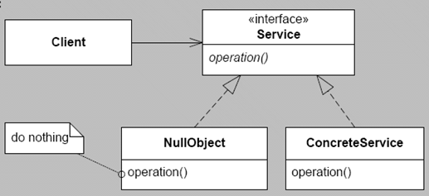
A Solution
The problem
Representing ‘absence’ by null
Can be solved by
Representing ‘absence’ with a special “absence object”:
The null object…
③-①-②:
‘Having or not having object’ is variable
Express ‘the object’ via an interface (‘service’ in the UML above)
Delegate to it
Allows a NullObject implementation to be injected…

Slide 6
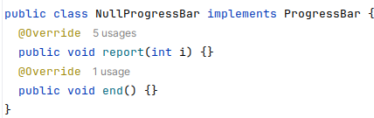
Thus
Instead of calling
lenghtyExecution(null);
… we call with a null object
lengthyExecution( new NullProgressBar() );

Slide 7
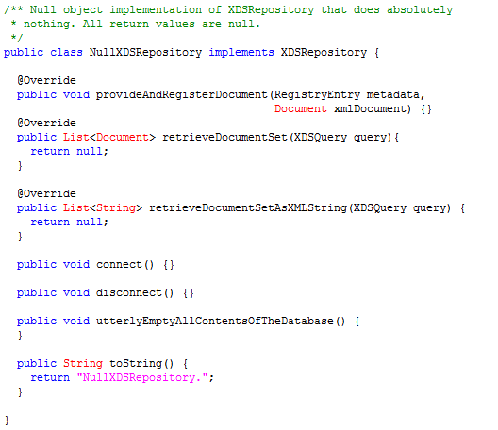
Example: Net4Care
TDD of AppServer which stores documents in XDS.b (database system)
SOAP messages containing ebXML payload sent to web service on remote machine that connects a MicroSoft SQLServer 2008!
But but, I am only interested in testing internal stuff...

Slide 8
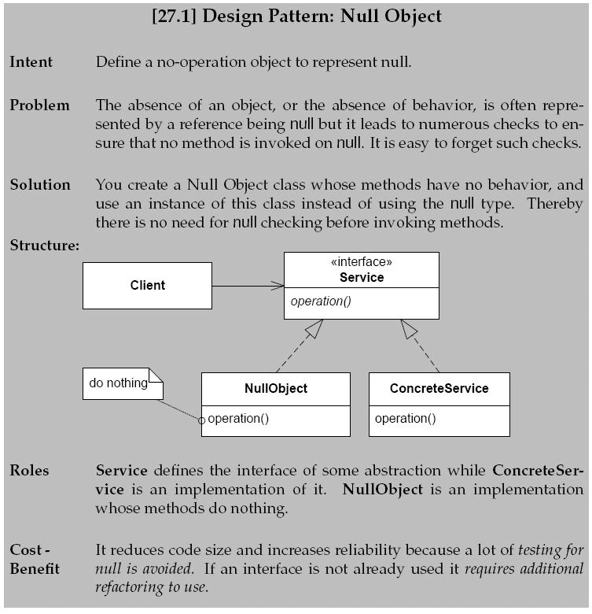

Slide 9
Modern Languages…
… tries to tackle it at language level

Slide 10


Paths to avoid the issue…
Lots of work to handle it better
Kotlin – you can explicitly state that a reference cannot be null
You cannot call a method on a nullable
Must use the ‘null safe operator’ ?.
nullable?.toLowerCase()
(Often called the ‘elvis’ operator)
Also in C# and Groovy

Slide 11

Java: Optional<T>
Java 8 introduced Optional which is a wrapper or a kind of proxy
Optional has an inner object which may be null
… and methods to handle the inner object
Our example
Hmmm – compare analyzability to the elvis operator
progress?.report(10);

